Slide 1


Lavazza Project

Slide 2

Table of Contents
Value Proposition
Project Goal
Sustainable Development Goal
Stakeholder Map
User Persona
User Journey
Project Design
Project Management
Checkpoint 1

Slide 3
Project Value Proposition
For marketers seeking deeper insights on product launches, our analytics software transforms raw online comments and reviews into actionable metrics.

Slide 4
Project Goal
Developing an application software in order to understand the real impact of a product launch, in terms of consumers sentiment crossing social media comments and third-party reviews.

Slide 5

Sustainable Development Goal
Responsible consumption
and production

Slide 6
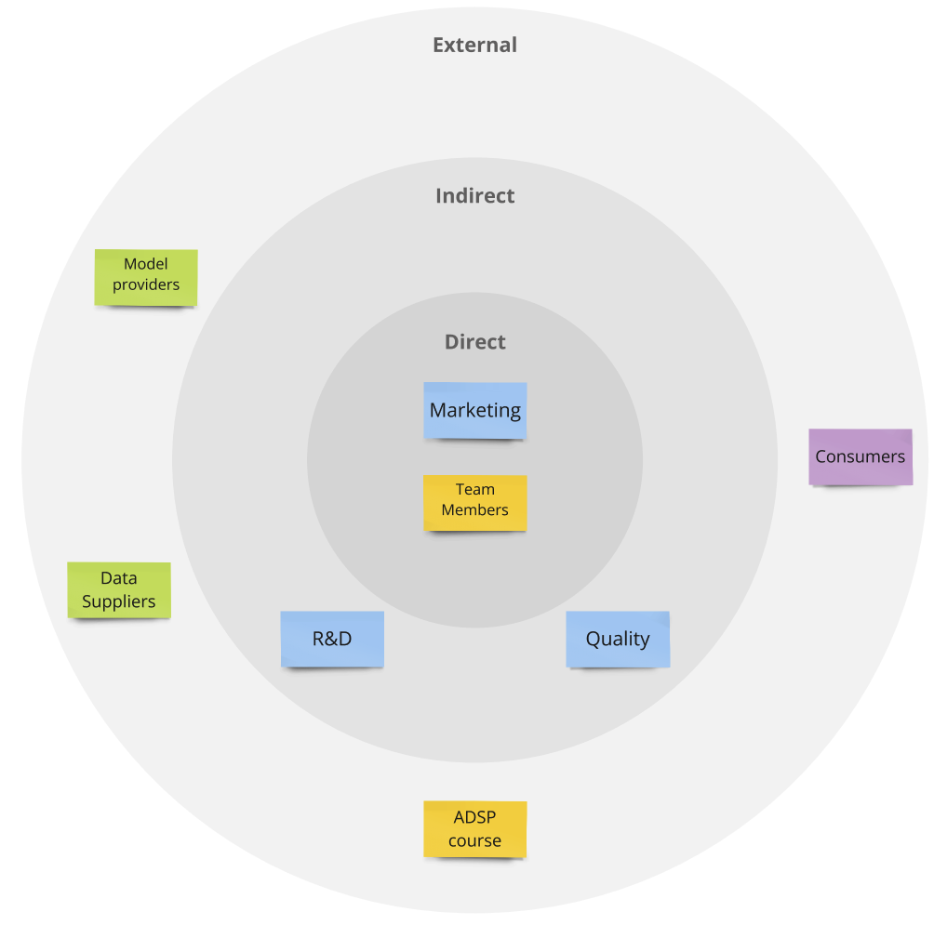
Stakeholder Map
Model providers include:
Hugging Face
Pytorch
Data suppliers include:
Wonderflow
Digimind
X
Meta
Youtube

Slide 7
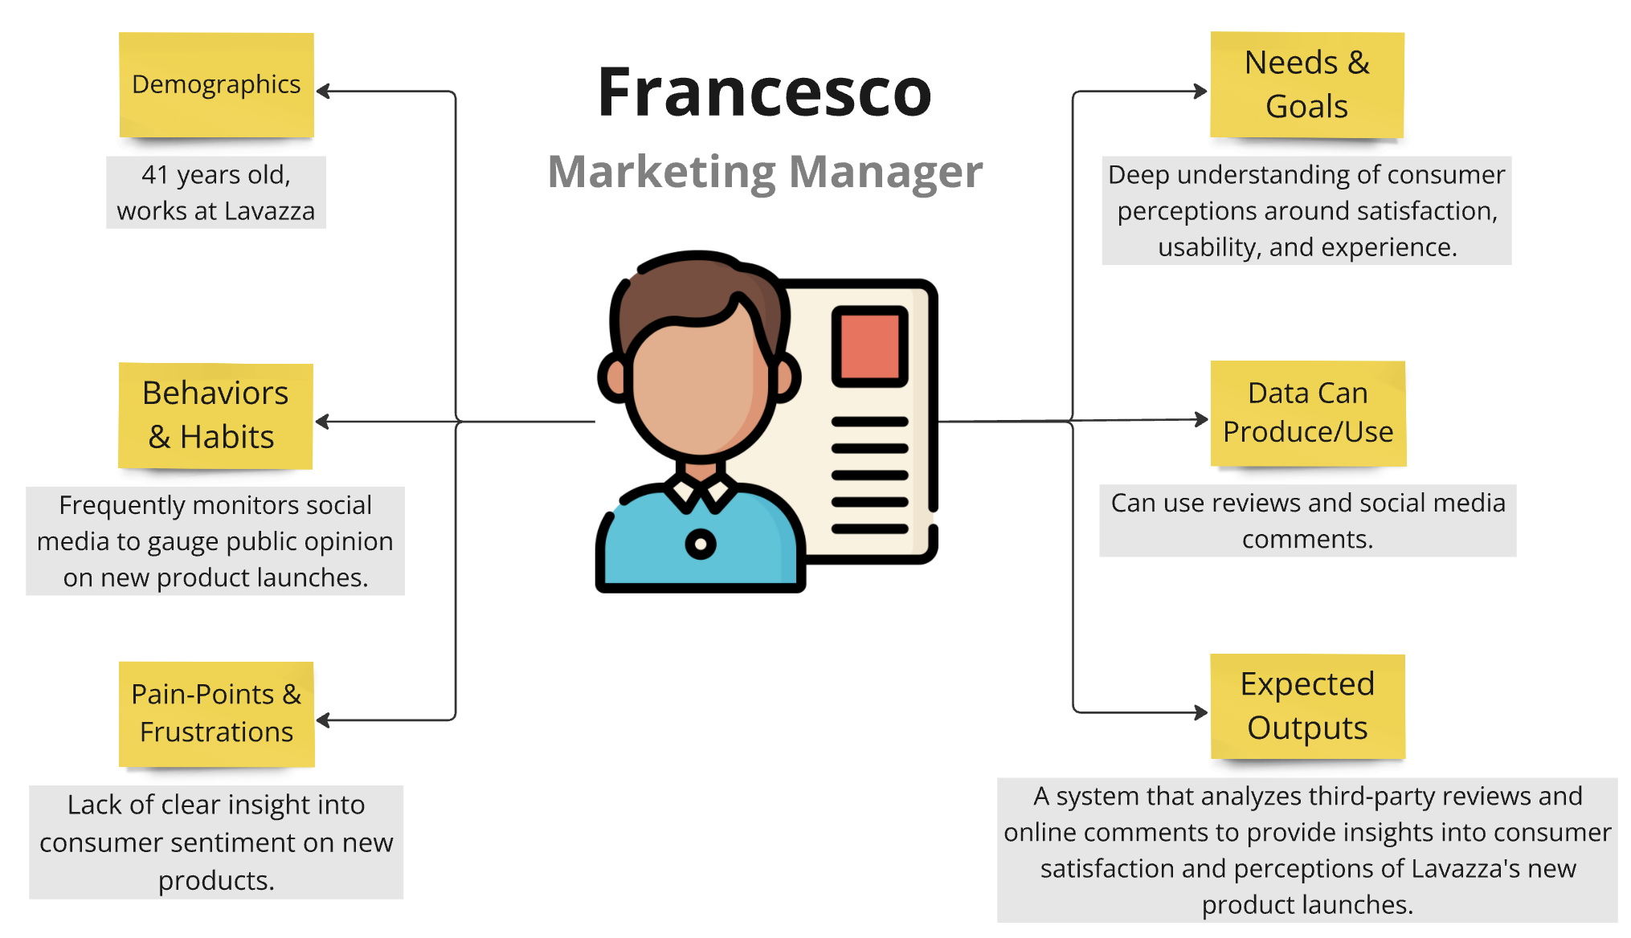
User Persona

Slide 8
User Journey
Francesco gathers feedbacks on new products from social media and reviews, but the process is long and inaccurate
Francesco decides to develop a customized AI system with Politecnico di Torino students, considering their potential inexperience.
Francesco exploits useful insights to drive marketing decisions and boost customer loyalty.
Loyalty and Advocacy
Awareness
Decision
Delivery and Use
Consideration
Francesco searches online for tools capable to analyze comments and reviews, but finding the right ones is not easy.
Francesco uses the AI system to analyze feedback and understand customer sentiments about Lavazza products, though it requires initial effort.

Slide 9
Design - User Requirements
ID | Description | Priority
FR1 | Ability to collect and integrate data from different sources | Must have
FR2 | Ability to infer sentiment | Must have
FR3 | Ability to evaluate aspects of the products | Must have
FR4 | Ability to provide reports | Must have
FR5 | Ability to segment the audience | Should have
NFR1 | Performance | Must have
NFR2 | Reliability | Must have
NFR3 | Usability | Must have

Slide 10
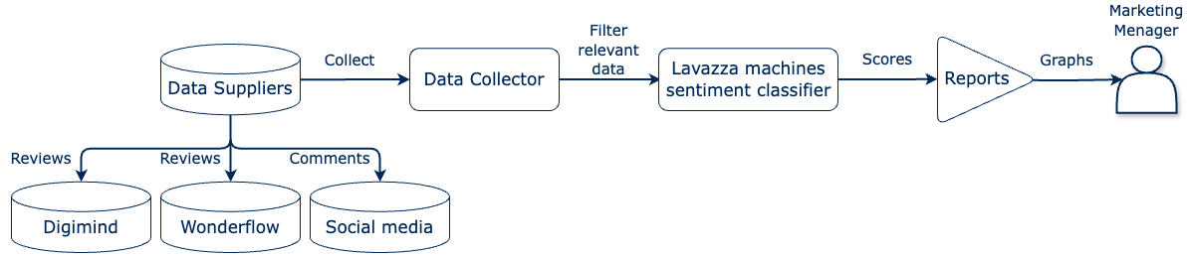
Design - System diagrams

Slide 11
Manage - Work breakdown structure
Work process | Start date | End date
WP1: Project Management | 28/10/2024 | 13/11/2024
WP2: Data Preparation | 14/11/2024 | 05/12/2024
WP3: Model Development | 05/12/2024 | 09/01/2024
WP4: Communication | 04/11/2024 | 09/01/2024

Slide 12
Manage - Work breakdown structure
WP1: Project Management
T1.1: Project definition
T1.2: Design Plan
T1.3: Management Plan
WP2: Data Preparation
T2.1: Data Collection
T2.2: Data Cleaning
WP3: Model Development
T3.1: Model Selection & Training
T3.2: Model Evaluation
WP4: Communication
T4.1: Meetings with Lavazza
T4.2: Checkpoint Preparation
T4.3: Final Presentation

Slide 13
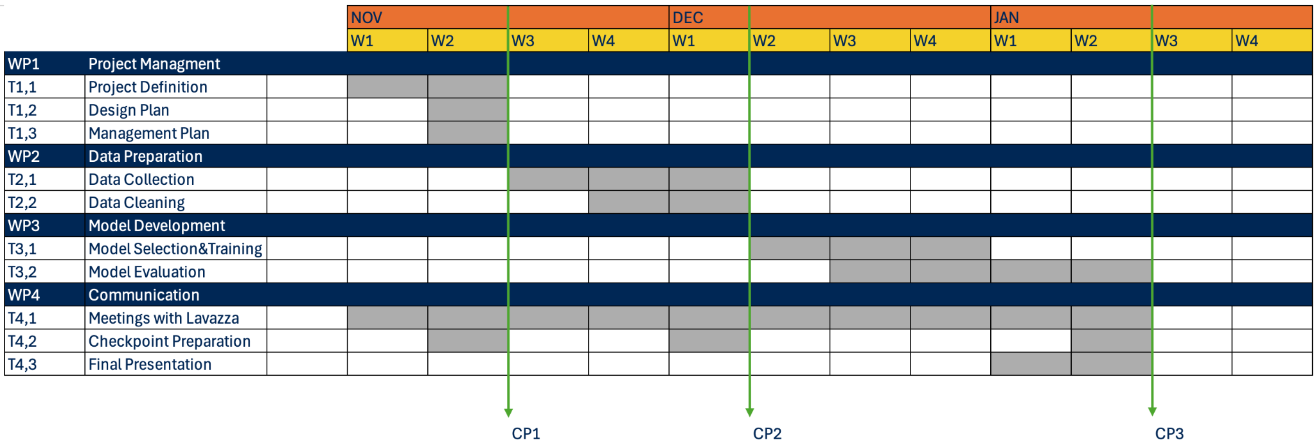
Manage - Gantt
: COMPLETED
(14/11/2024)
(05/12/2024)
(09/01/2025)

Slide 14
Thank you
Alessio Gioè - Catalano Vincenzo - Tommaso Mazzarini

